Slide 1
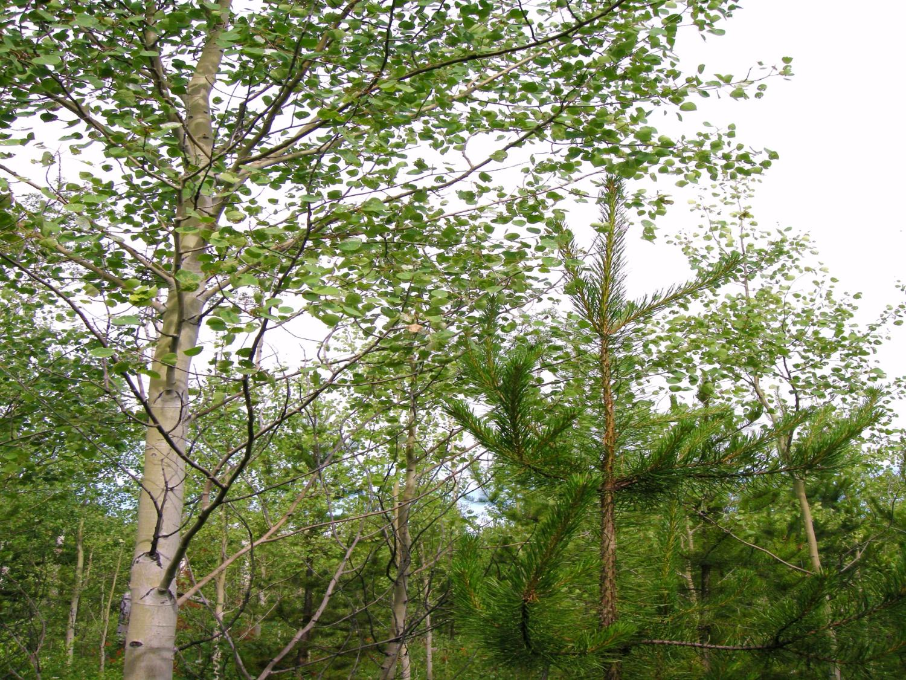
Free Growing Standards & Appendix 9
“An Update”
Dave Weaver Resource Practices Branch
FFT Meeting Sept 2013

Slide 2

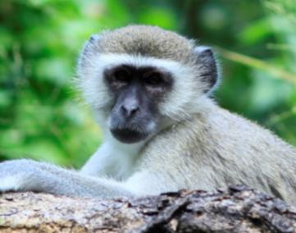
“The Story of US and THEM Continues...”
THEM
US
Appendix 9 – How much Broadleaf is too much?

Slide 3
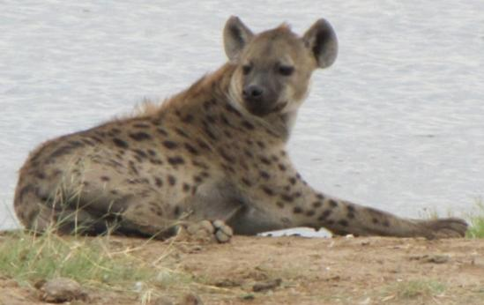
Appendix 9 → 13 What’s the Plan?
The Catalyst for Change – the Cariboo and Newsome work
Old Appendix 9 review
New Appendix 13 - Project Plan – Timelines
Teresa Newsome’s Work
George Harper’s Work
Vision for Appendix 13 - Format
  Manual Update, New Appendix and Cariboo Pilot, Neighbourhood Concept
What would you change??

Slide 4
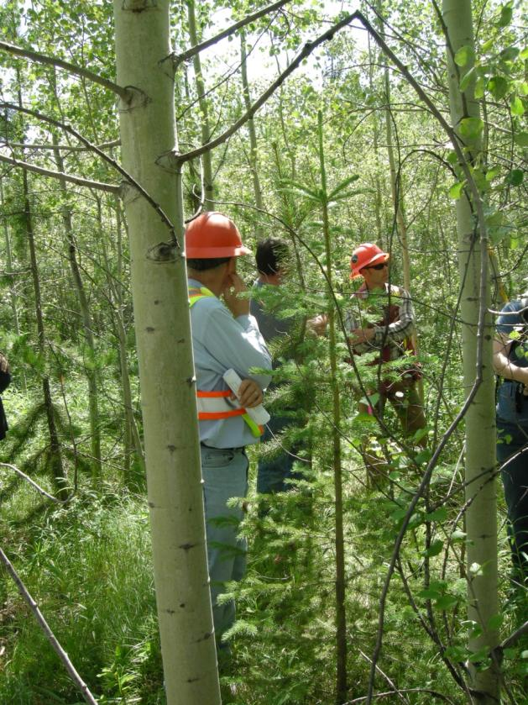
The Catalyst for Change
Teresa Newsome's extensive long term research work in SBPS, IDF and SBS
Proposes ↑ Allowable At per FG Plot - mostly Pl
Request amendments to Appendix 9 in 2013
“Time to take a good look at the entire Appendix 9”

Slide 5

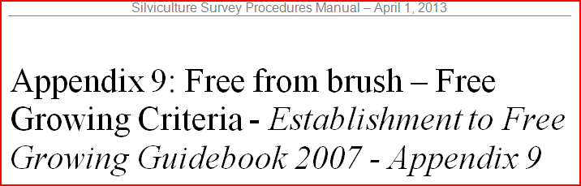
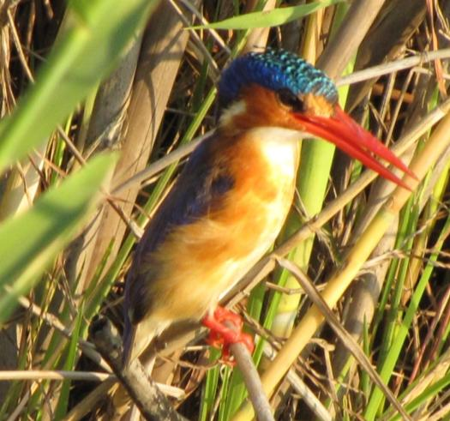
Old Appendix 9 Review

Slide 6
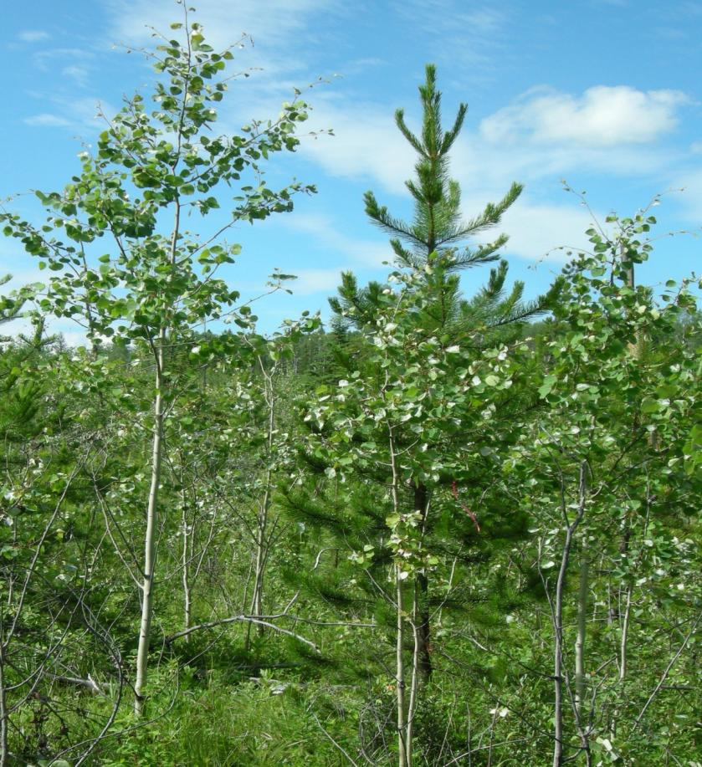
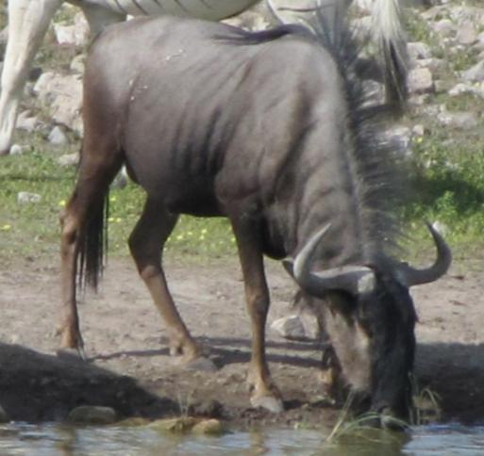
Appendix 9 – Quadrant &
Potentially FG Method

Slide 7
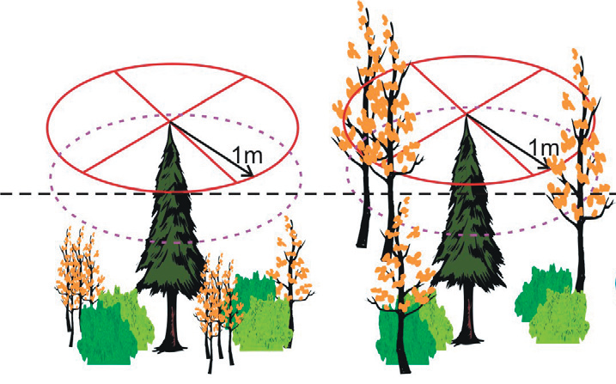
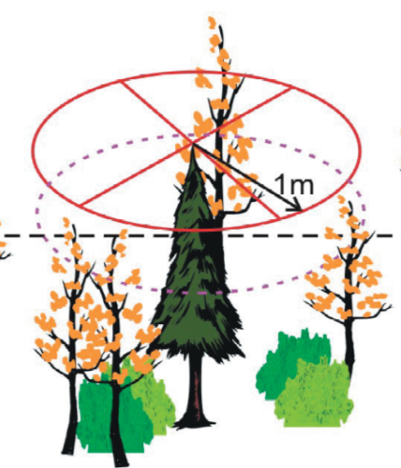
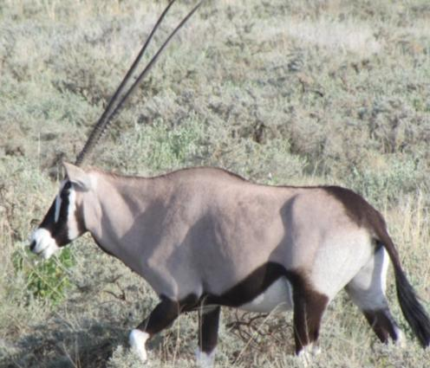
Broadleaf Brush Competition
Conifer
/ Brush
Ratio
Free Growing
Not Free Growing
Potentially Free Growing

Slide 8
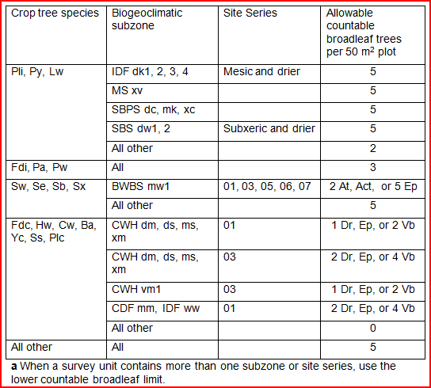
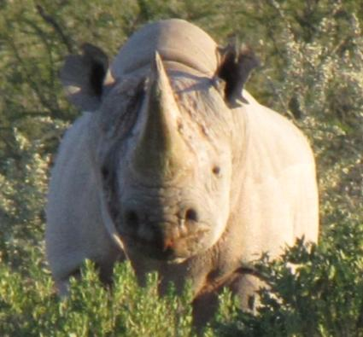
Allowable Amount of Broadleaf / Plot – if a Potentially FG tree in a Plot

Slide 9
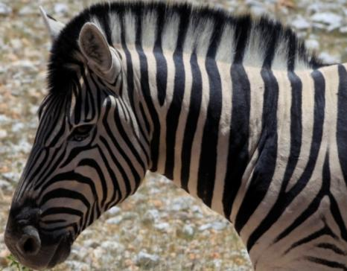
New Appendix 13 - Project Plan Timelines
Sept 2013
Nov 2013
March 2014
Summer 2014
Fall 2014
Spring 2015
Finish Field Work Newsome and Harper
Survey Licensees for Feedback
Produce 1st Cariboo Pilot
Test Pilot – Volunteer Licensees
Open Input on App. 13 Design
Final Cariboo Pilot
Final Appendix 13 Format

Slide 10
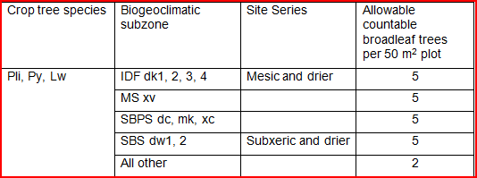
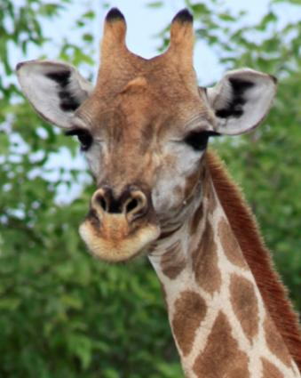
Teresa Newsome’s Work
Cariboo – At less competitor in drier subzones
Better to assess 1.8 m radius for Quadrant Method
At can be 25% taller in 2 Quadrants to FG
2
15
1
Non-deleterious
3
All

Slide 11
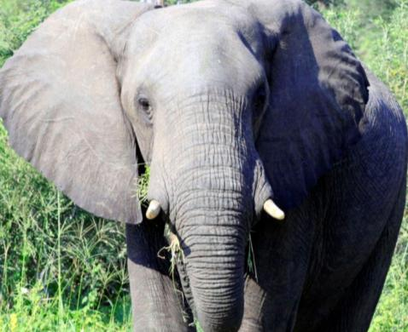
George Harper’s Work
Retrospective study of Northern SBS
Assessing resultant competition levels between post FG Pl and competitive levels of At
Assessing competition relative to Appendix 9 Criteria
Hopefully will update Appendix 13 ( criteria for these northern SBS subzones)

Slide 12
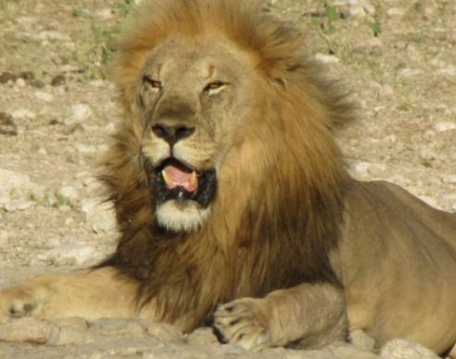
Vision for Appendix 13 - Format
Choices??
Amend Appendix 9 – one line at a time per year – adding additional complexity to an already complex/confusing document
OR
Develop Appendix 13 – with a clearer Template for future Amendments with the Cariboo as the Pilot for changes

Slide 13
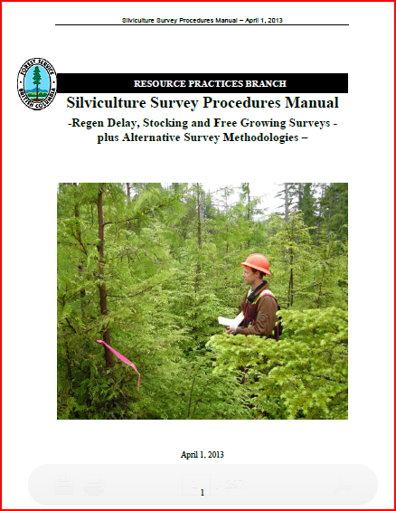
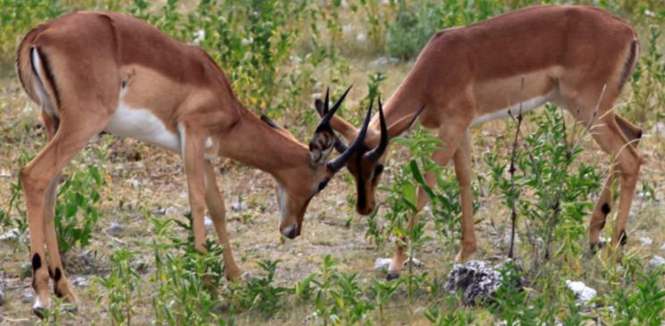
Appendix 13 – Thoughts to date+/-
Silviculture Surveys Manual
3.4 Free Growing Surveys
  3.4.2 Free Criteria: Guidance Procedures for the Assessment of Vegetation Competition in Managed conifer Stands (link to App 13)
Appendix 13
  Regional Tables by BEC

Slide 14
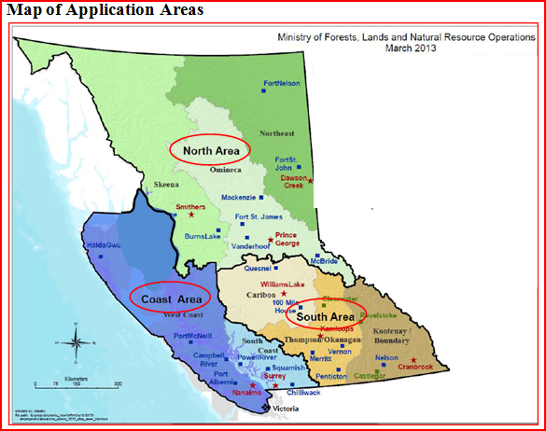
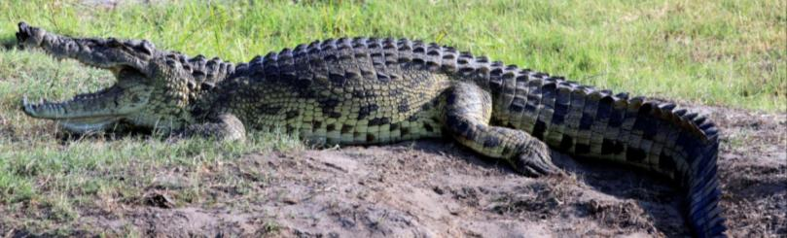
Appendix 13
Each Regional Area
“Relative to Broadleaf Competiveness”
TSA’s included
Shrub & Herb Comp
Broadleaf Comp
  Decision Flow Chart & Table per BEC, per Species (Conifer and Broadleaf)
Assessment Methodology

Slide 15
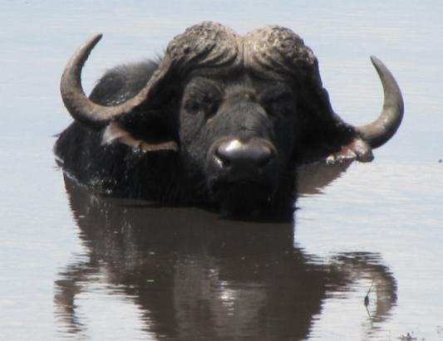
Appendix 13
Cariboo will be the Pilot for Format change
  BEC – subzone specific, site series, species specific
Probably focus on “Neighbourhood “ concept for competition rather than “Potentially FG “ concept

Slide 16
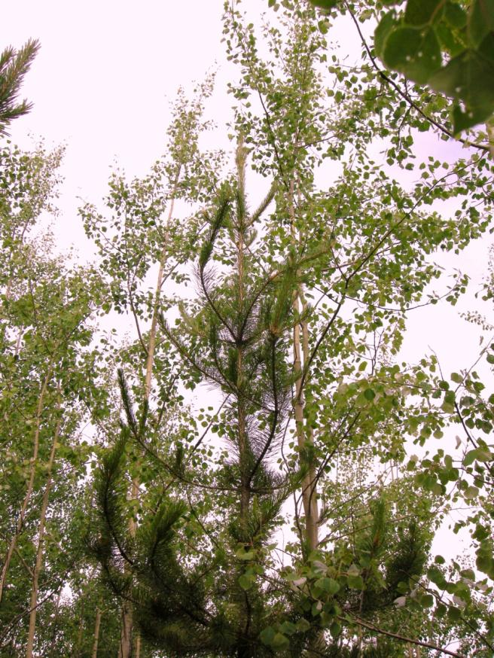
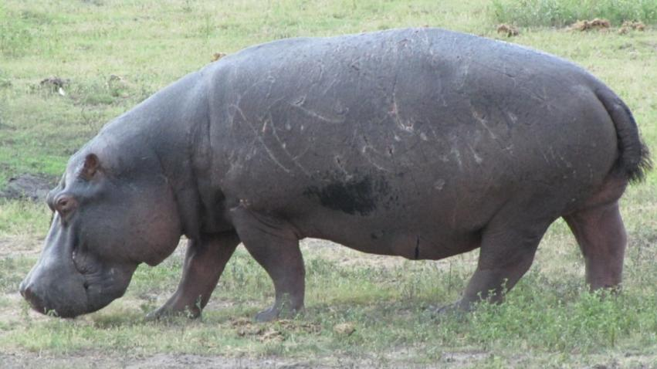
What would you change to Appendix 9??
Can you name the “Big 5”?

